Slide 1

William Stallings, Computer Organization and Architecture, 9th Edition
Parallel
Processing
Chapter 17
Notes:
Lecture slides prepared for “Computer Organization and Architecture”, 9/e, by William Stallings, Chapter 17 “Parallel Processing”.
Adapted by Thân Văn Sử
Traditionally, the computer has been viewed as a sequential machine. Most computer programming languages require the programmer to specify algorithms as sequences of instructions. Processors execute programs by executing machine instructions in a sequence and one at a time. Each instruction is executed in a sequence of operations (fetch instruction, fetch operands, perform operation, store results).
This view of the computer has never been entirely true. At the micro-operation level, multiple control signals are generated at the same time. Instruction pipelining, at least to the extent of overlapping fetch and execute operations, has been around for a long time. Both of these are examples of performing functions in parallel. This approach is taken further with superscalar organization, which exploits instruction- level parallelism. With a superscalar machine, there are multiple execution units within a single processor, and these may execute multiple instructions from the same program in parallel.
As computer technology has evolved, and as the cost of computer hardware has dropped, computer designers have sought more and more opportunities for
parallelism, usually to enhance performance and, in some cases, to increase availability. After an overview, this chapter looks at some of the most prominent approaches to parallel organization. First, we examine symmetric multiprocessors (SMPs), one of the earliest and still the most common example of parallel organization. In an SMP organization, multiple processors share a common memory. This organization raises the issue of cache coherence, to which a separate section is devoted. Next, the chapter examines multithreaded processors and chip multiprocessors. Then we describe clusters, which consist of multiple independent computers organized in a cooperative fashion. Clusters have become increasingly common to support workloads that are beyond the capacity of a single SMP. Another approach to the use of multiple processors that we examine is that of non-uniform memory access (NUMA) machines. The NUMA approach is relatively new and not yet proven in the marketplace, but is often considered as an alternative to the SMP or cluster approach. Finally, this chapter looks at hardware organizational approaches to vector computation. These approaches optimize the ALU for processing vectors or arrays of floating-point numbers. They are common on the class of systems known as supercomputers.

Slide 2
Objectives
You are profiting from multiple CPU computers, You should know about them.
After studying this chapter, you should be able to:
Summarize the types of parallel processor organizations.
Present an overview of design features of symmetric multiprocessors. Understand the issue of cache coherence in a multiple processor system.
Explain the key features of the MESI protocol.
Explain the difference between implicit and explicit multithreading. Summarize key design issues for clusters.

Slide 3
Contents
17.1 Multiple Processor Organizations
17.2 Symmetric Multiprocessors
17.3 Cache Coherence and the MESI Protocol
17.4 Multithreading and Chip Multiprocessors

Slide 4
17.1- Multiple Processor Organization
Single instruction, single data (SISD) stream
  Single processor executes a single instruction stream to operate on data stored in a single memory
  Uniprocessors fall into this category
Multiple instruction, single data (MISD) stream
  A sequence of data is transmitted to a set of processors, each of which executes a different instruction sequence
  Not commercially implemented
Single instruction, multiple data (SIMD) stream
  A single machine instruction controls the simultaneous execution of a number of processing elements on a lockstep basis
  Vector and array processors fall into this category
Multiple instruction, multiple data (MIMD) stream
  A set of processors simultaneously execute different instruction sequences on different data sets
  SMPs, clusters and NUMA systems fit this category
Notes:
A taxonomy first introduced by Flynn [FLYN72] is still the most common way of categorizing systems with parallel processing capability. Flynn proposed the following categories of computer systems:
Single instruction, single data (SISD) stream: A single processor executes a single instruction stream to operate on data stored in a single memory. Uniprocessors fall into this category.
Single instruction, multiple data (SIMD) stream: A single machine instruction controls the simultaneous execution of a number of processing elements on a lockstep basis. Each processing element has an associated data memory, so that instructions are executed on different sets of data by different processors. Vector and array processors fall into this category, and are discussed in Section 18.7.
Multiple instruction, single data (MISD) stream: A sequence of data is transmitted to a set of processors, each of which executes a different instruction sequence. This structure is not commercially implemented.
Multiple instruction, multiple data (MIMD) stream: A set of processors simultaneously execute different instruction sequences on different data sets. SMPs, clusters, and NUMA systems fit into this category.

Slide 5
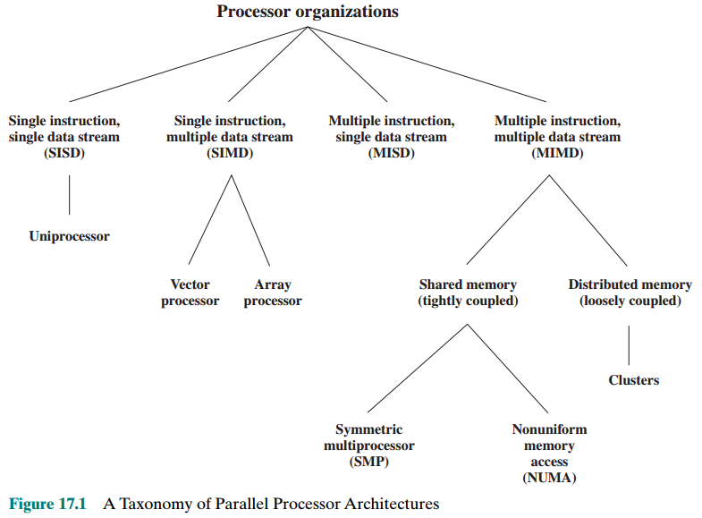
Parallel Organizations
Notes:
With the MIMD organization, the processors are general purpose; each is able to process all of the instructions necessary to perform the appropriate data transformation. MIMDs can be further subdivided by the means in which the processors communicate (Figure 17.1). If the processors share a common memory, then each processor accesses programs and data stored in the shared memory, and processors communicate with each other via that memory. The most common form of such system is known as a symmetric multiprocessor (SMP), which we examine in Section 17.2. In an SMP, multiple processors share a single memory or pool of memory by means of a shared bus or other interconnection mechanism; a distinguishing feature is that the memory access time to any region of memory is approximately the same for each processor. A more recent development is the non-uniform memory access (NUMA) organization, which is described in Section 17.5. As the name suggests, the memory access time to different regions of memory may differ for a NUMA processor.
A collection of independent uniprocessors or SMPs may be interconnected to form a cluster. Communication among the computers is either via fixed paths or via some network facility.

Slide 6
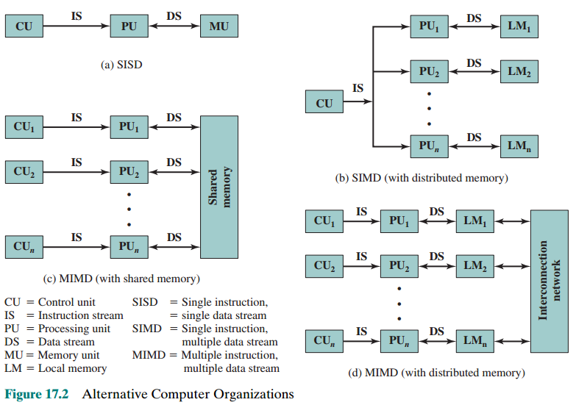
Parallel Organizations
Notes:
Figure 17.2 illustrates the general organization of the taxonomy of Figure 17.1. Figure 17.2a shows the structure of an SISD. There is some sort of control unit (CU) that provides an instruction stream (IS) to a processing unit (PU). The processing unit operates on a single data stream (DS) from a memory unit (MU). With an
SIMD, there is still a single control unit, now feeding a single instruction stream to multiple PUs. Each PU may have its own dedicated memory (illustrated in Figure 17.2b), or there may be a shared memory. Finally, with the MIMD, there are multiple control units, each feeding a separate instruction stream to its own PU. The MIMD may be a shared-memory multiprocessor (Figure 17.2c) or a distributed- memory multicomputer (Figure 17.2d).
The design issues relating to SMPs, clusters, and NUMAs are complex, involving issues relating to physical organization, interconnection structures, inter-processor communication, operating system design, and application software techniques. Our concern here is primarily with organization, although we touch briefly on operating system design issues.

Slide 7
17.2- Symmetric Multiprocessor (SMP)
A SMP can be defined as a stand alone computer with the following characteristics:
Two or more similar processors of comparable capacity
Processors share same memory and I/O facilities
Processors are connected by a bus or other internal connection
Memory access time is approximately the same for each processor
All processors share access to I/O devices
Either through same channels or different channels giving paths to same devices
All processors can perform the same functions (hence “symmetric”)
System controlled by integrated operating system
Provides interaction between processors and their programs at job, task, file and data element levels
Notes:
Until fairly recently, virtually all single-user personal computers and most workstations contained a single general-purpose microprocessor. As demands for performance increase and as the cost of microprocessors continues to drop, vendors have introduced systems with an SMP organization. The term SMP refers to a computer hardware architecture and also to the operating system behavior that reflects that architecture. An SMP can be defined as a standalone computer system with the following characteristics:
1. There are two or more similar processors of comparable capability.
2.These processors share the same main memory and I/O facilities and are interconnected by a bus or other internal connection scheme, such that memory access time is approximately the same for each processor.
3. All processors share access to I/O devices, either through the same channels or through different channels that provide paths to the same device.
4. All processors can perform the same functions (hence the term symmetric).
5. The system is controlled by an integrated operating system that provides interaction between processors and their programs at the job, task, file, and data element levels.
Points 1 to 4 should be self-explanatory. Point 5 illustrates one of the contrasts
with a loosely coupled multiprocessing system, such as a cluster. In the latter, the physical unit of interaction is usually a message
or complete file. In an SMP, individual data elements can constitute the level of interaction, and there can be a high degree of cooperation
between processes.

Slide 8
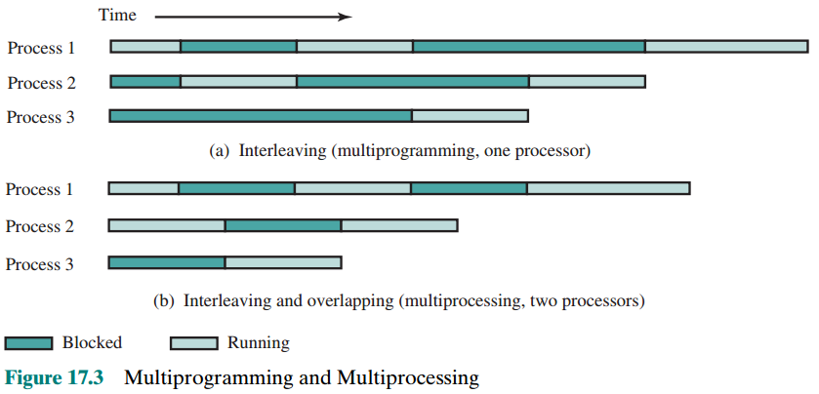
Multiprogramming and Multiprocessing
The operating system of an SMP schedules processes or threads across all of the processors. SMP has a number of potential advantages over a uni-processor organization, including the following: Performance, availability, incremental growth (user can add processors), scaling (Vendors can offer a range of products with different configures)
Notes:
The operating system of an SMP schedules processes or threads across all of the processors. An SMP organization has a number of potential advantages over a uniprocessor organization, including the following:
• Performance: If the work to be done by a computer can be organized so that some portions of the work can be done in parallel, then a system with multiple processors will yield greater performance than one with a single processor of the same type (Figure 17.3).
* Availability: In a symmetric multiprocessor, because all processors can perform the same functions, the failure of a single processor
does not halt the machine. Instead, the system can continue to function at reduced performance.
* Incremental growth: A user can enhance the performance of a system by adding an additional processor.
* Scaling: Vendors can offer a range of products with different price and performance characteristics based on the number of processors configured in the system.
It is important to note that these are potential, rather than guaranteed, benefits. The operating system must provide tools and functions to exploit the parallelism in an SMP system.
An attractive feature of an SMP is that the existence of multiple processors is transparent to the user. The operating system takes care of scheduling of threads or processes on individual processors and of synchronization among processors.

Slide 9
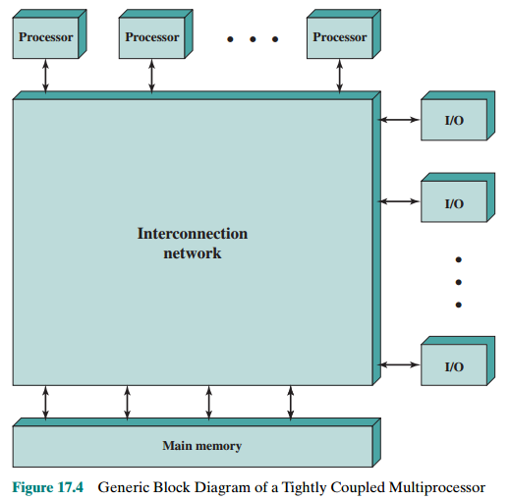
Organization: Tightly Coupled
Each processor is self-contained (CU, registers, one or more caches).
Shared main memory and I/O devices through some form of interconnection mechanism.
Processors can communicate with each other through memory.
A processor can exchange signals directly to each other.
The memory is often organized so that multiple simultaneous accesses to separate blocks of memory are possible.
In some configurations, each processor may also have its own private main memory and I/O channels in addition to the shared resources.

Slide 10
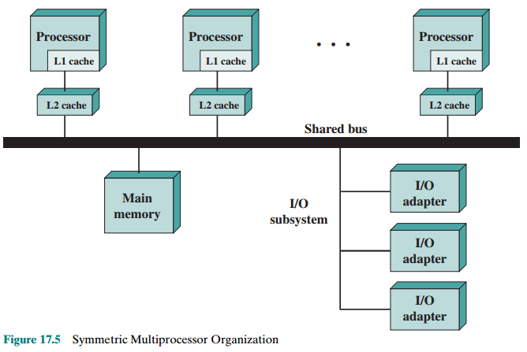
Organization: Symmetric Multiprocessor
The most common organization for personal computers, workstations, and servers is the time-shared bus. The time-shared bus is the simplest mechanism for constructing a multiprocessor system.
The structure and interfaces are basically the same as for a single-processor system that uses a bus interconnection. The bus consists of control, address, and data lines
DMA:
• Addressing: <source, destination>
• Arbitration: Any I/O module can be “master.”
• Time-sharing
Notes:
The most common organization for personal computers, workstations, and servers is the time-shared bus. The time-shared bus is the simplest mechanism for constructing a multiprocessor system (Figure 17.5). The structure and interfaces are basically the same as for a single-processor system that uses a bus interconnection. The bus consists of control, address, and data lines. To facilitate DMA transfers from I/O subsystems to processors, the following features are provided:
Addressing: It must be possible to distinguish modules on the bus to determine the source and destination of data.
Arbitration: Any I/O module can temporarily function as “master.” A mechanism is provided to arbitrate competing requests for bus control, using some sort of priority scheme.
Time-sharing: When one module is controlling the bus, other modules are locked out and must, if necessary, suspend operation until bus access is achieved.
These uniprocessor features are directly usable in an SMP organization. In this latter case, there are now multiple processors as well as multiple I/O processors all attempting to gain access to one or more memory modules via the bus.

Slide 11

The bus organization has several
attractive features:
Simplicity
  Simplest approach to multiprocessor organization
Flexibility
  Generally easy to expand the system by attaching more processors to the bus
Reliability
  The bus is essentially a passive medium and the failure of any attached device should not cause failure of the whole system
Notes:
The bus organization has several attractive features:
• Simplicity: This is the simplest approach to multiprocessor organization. The physical interface and the addressing, arbitration,
and time-sharing logic of each processor remain the same as in a single-processor system.
• Flexibility: It is generally easy to expand the system by attaching more processors to the bus.
• Reliability: The bus is essentially a passive medium, and the failure of any attached device should not cause failure of the whole system.

Slide 12
Disadvantages of the bus organization:
Main drawback is performance
  All memory references pass through the common bus
  Performance is limited by bus cycle time
Each processor should have cache memory
  Reduces the number of bus accesses
Leads to problems with cache coherence
  If a word is altered in one cache it could conceivably invalidate a word in another cache
    To prevent this the other processors must be alerted that an update has taken place
  Typically addressed in hardware rather than the operating system
Notes:
The main drawback to the bus organization is performance. All memory references pass through the common bus. Thus, the bus cycle time limits the speed of the system. To improve performance, it is desirable to equip each processor with a cache memory. This should reduce the number of bus accesses dramatically. Typically, workstation and PC SMPs have two levels of cache, with the L1 cache internal (same chip as the processor) and the L2 cache either internal or external. Some processors now employ a L3 cache as well.
The use of caches introduces some new design considerations. Because each local cache contains an image of a portion of memory, if a word is altered in one
cache, it could conceivably invalidate a word in another cache. To prevent this, the other processors must be alerted that an update has taken place. This problem is known as the cache coherence problem and is typically addressed in hardware rather than by the operating system.

Slide 13
Multiprocessor Operating System Design Considerations
Simultaneous concurrent processes
  OS routines need to be reentrant (center) to allow several processors to execute the same OS code (OS service) simultaneously
  OS tables and management structures must be managed properly to avoid deadlock or invalid operations
Scheduling
  Any processor may perform scheduling so conflicts must be avoided
  Scheduler must assign ready processes to available processors
Synchronization
  With multiple active processes having potential access to shared address spaces or I/O resources, care must be taken to provide effective synchronization
  Synchronization is a facility that enforces mutual exclusion and event ordering
mutual exclusion: loại trừ hỗ tương, cơ chế độc chiếm tài nguyên, một nguyên nhân gây deadlock
Notes:
An SMP operating system manages processor and other computer resources so that the user perceives a single operating system controlling system resources. In fact, such a configuration should appear as a single-processor multiprogramming system. In both the SMP and uniprocessor cases, multiple jobs or processes may be active at one time, and it is the responsibility of the operating system to schedule their execution and to allocate resources. A user may construct applications that use multiple processes or multiple threads within processes without regard to whether a single processor or multiple processors will be available. Thus, a multiprocessor operating system must provide all the functionality of a multiprogramming system plus additional features to accommodate multiple processors. Among the key design issues:
Simultaneous concurrent processes: OS routines need to be reentrant to allowseveral processors to execute the same OS code simultaneously. With multiple processors executing the same or different parts of the OS, OS tables and management structures must be managed properly to avoid deadlock or invalid operations.
Scheduling: Any processor may perform scheduling, so conflicts must be avoided. The scheduler must assign ready processes to available processors.
Synchronization: With multiple active processes having potential access to shared address spaces or shared I/O resources, care must be taken to provide effective synchronization. Synchronization is a facility that enforces mutual exclusion and event ordering.
Memory management: Memory management on a multiprocessor must deal with all of the issues found on uniprocessor machines, as is discussed in Chapter 8. In addition, the operating system needs to exploit the available hardware parallelism, such as multi-ported memories, to achieve the best performance. The paging mechanisms on different processors must be coordinated to enforce consistency when several processors share a page or segment and to decide on page replacement.
Reliability and fault tolerance: The operating system should provide graceful degradation in the face of processor failure. The scheduler and other portions of the operating system must recognize the loss of a processor and restructure management tables accordingly.

Slide 14
Multiprocessor Operating System Design Considerations…
Memory management
  In addition to dealing with all of the issues found on uniprocessor machines, the OS needs to exploit the available hardware parallelism to achieve the best performance
  Paging mechanisms on different processors must be coordinated to enforce consistency when several processors share a page or segment and to decide on page replacement
Reliability and fault tolerance
  OS should provide graceful degradation (suy giảm) in the face of processor failure
  Scheduler and other portions of the operating system must recognize the loss of a processor and restructure accordingly

Slide 15
17.3- Cache Coherence and the MESI Protocol
Review:
Write back: Write operations are usually made only to the cache. Main memory is only updated when the corresponding cache line is flushed from the cache → can result in inconsistency
Write through: All write operations are made to main memory as well as to the cache, ensuring that main memory is always valid. Even with the write-through policy, inconsistency can occur unless other caches monitor the memory traffic or receive some direct notification of the update
➔ MESI (4 states of a data in a cache: modified/exclusive/ shared/invalid) protocol is recommended here.
Notes:
Coherent: sticking together – cố kết
Consistency: disambiguation- nhất quán, không nhập nhằng
Protocol: way including some steps for communication- giao thức

Slide 16
Cache Coherence…
Software Solutions
Attempt to avoid the need for additional hardware circuitry and logic by relying on the compiler and operating system to deal with the problem (không muốn thêm phần cứng)
Attractive because the overhead of detecting potential problems is transferred from run time to compile time, and the design complexity is transferred from hardware to software
  However, compile-time software approaches generally must make conservative decisions, leading to inefficient cache utilization
Notes:
Software cache coherence schemes attempt to avoid the need for additional hard- ware circuitry and logic by relying on the compiler and operating system to deal with the problem. Software approaches are attractive because the overhead of detecting potential problems is transferred from run time to compile time, and the design complexity is transferred from hardware to software. On the other hand, compile- time software approaches generally must make conservative decisions, leading to inefficient cache utilization.
Compiler-based coherence mechanisms perform an analysis on the code to determine which data items may become unsafe for caching, and they mark those items accordingly. The operating system or hardware then prevents non-cacheable items from being cached.
The simplest approach is to prevent any shared data variables from being cached. This is too conservative, because a shared data structure may be exclusively used during some periods and may be effectively read-only during other periods. It is only during periods when at least one process may update the variable and at least one other process may access the variable that cache coherence is an issue.
More efficient approaches analyze the code to determine safe periods for shared variables. The compiler then inserts instructions into the generated code to enforce cache coherence during the critical periods. A number of techniques have been developed for performing the analysis and for enforcing the results; see [LILJ93] and [STEN90] for surveys.

Slide 17
Cache Coherence…
Hardware-Based Solutions
Generally referred to as cache coherence protocols
These solutions provide dynamic recognition at run time of potential inconsistency conditions
Because the problem is only dealt with when it actually arises there is more effective use of caches, leading to improved performance over a software approach
Approaches are transparent to the programmer and the compiler, reducing the software development burden
Can be divided into two categories:
  Directory protocols: the data being shared is placed in a common directory that maintains the coherence between caches
  Snoopy protocols: every cache controller monitors the bus, listening for broadcasts which may cause it to invalidate its cache line
Notes:
Transparent: unable to see- trong suốt
Snoop: spy, rình mò, thăm dò
Hardware-based solutions are generally referred to as cache coherence protocols. These solutions provide dynamic recognition at run time of potential inconsistency conditions. Because the problem is only dealt with when it actually arises, there is more effective use of caches, leading to improved performance over a software approach. In addition, these approaches are transparent to the programmer and the compiler, reducing the software development burden.
Hardware schemes differ in a number of particulars, including where the state information about data lines is held, how that information is organized, where coherence is enforced, and the enforcement mechanisms. In general, hardware schemes can be divided into two categories: directory protocols and snoopy protocols.

Slide 18
Directory Protocols
There is a centralized controller that is part of the main memory controller
Collect and maintain information about copies of data in cache
Directory stored in main memory
Requests are checked against directory
Appropriate transfers are performed
Creates central bottleneck
Effective in large scale systems with complex interconnection schemes
In a directory-based system, the data being shared is placed in a common directory that maintains the coherence between caches. The directory acts as a filter through which the processor must ask permission to load an entry from the primary memory to its cache. When an entry is changed, the directory either updates or invalidates the other caches with that entry.
Notes:
Directory protocols collect and maintain information about where copies of lines reside. Typically, there is a centralized controller that is part of the main memory controller, and a directory that is stored in main memory. The directory contains global state information about the contents of the various local caches. When an individual cache controller makes a request, the centralized controller checks and issues necessary commands for data transfer between memory and caches or between caches. It is also responsible for keeping the state information up to date; therefore, every local action that can affect the global state of a line must be reported to the central controller.
Typically, the controller maintains information about which processors have a copy of which lines. Before a processor can write to a local copy of a line, it must request exclusive access to the line from the controller. Before granting this exclusive access, the controller sends a message to all processors with a cached copy of this line, forcing each processor to invalidate its copy. After receiving acknowledgments back from each such processor, the controller grants exclusive access to the requesting processor. When another processor tries to read a line that is exclusively granted to another processor, it will send a miss notification to the controller. The controller then issues a command to the processor holding that line that requires the processor to do a write back to main memory. The line may now be shared for reading by the original processor and the requesting processor.
Directory schemes suffer from the drawbacks of a central bottleneck and the overhead of communication between the various cache controllers and the central controller. However, they are effective in large-scale systems that involve multiple buses or some other complex interconnection scheme.

Slide 19

Snoopy Protocols
Distribute the responsibility for maintaining cache coherence among all of the cache controllers in a multiprocessor
  A cache must recognize when a line that it holds is shared with other caches
  When updates are performed on a shared cache line, it must be announced to other caches by a broadcast mechanism
  Each cache controller is able to “snoop – thăm dò” on the network to observe these broadcast notifications and react accordingly
Suited to bus-based multiprocessor because the shared bus provides a simple means for broadcasting and snooping
  Care must be taken that the increased bus traffic required for broadcasting and snooping does not cancel out the gains from the use of local caches
  Two basic approaches have been explored:
  Write invalidate
  Write update (or write broadcast)
Notes:
Snoopy protocols distribute the responsibility for maintaining cache coherence among all of the cache controllers in a multiprocessor. A cache must recognize when a line that it holds is shared with other caches.
When an update action is performed on a shared cache line, it must be announced to all other caches by a broadcast mechanism. Each cache controller is able to “snoop” on the network to observe these broadcasted notifications, and react accordingly.
Snoopy protocols are ideally suited to a bus-based multiprocessor, because the shared bus provides a simple means for broadcasting and snooping. However, because one of the objectives of the use of local caches is to avoid bus accesses, care must be taken that the increased bus traffic required for broadcasting and snooping does not cancel out the gains from the use of local caches.
Two basic approaches to the snoopy protocol have been explored: write invalidate and write update (or write broadcast).

Slide 20
Write Invalidate
Multiple readers, but only one writer at a time
When a write is required, all other caches of the line are invalidated (marked)
Writing processor then has exclusive (độc chiếm-cheap) access until line is required by another processor
Most widely used in commercial multiprocessor systems such as the Pentium 4 and PowerPC
State of every line is marked as modified, exclusive, shared or invalid
  For this reason the write-invalidate protocol is called MESI
Notes:
VD: sv làm bài cho các bạn khác chép, khi phát hiện mình bị sai thì SV này sẽ lấy lại vỡ và sữa lại quyền sữa này là trạng thái độc quyền
With a write-invalidate protocol, there can be multiple readers but only one writer at a time. Initially, a line may be shared among several caches for reading purposes. When one of the caches wants to per- form a write to the line, it first issues a notice that invalidates that line in the other caches, making the line exclusive to the writing cache. Once the line is exclusive, the owning processor can make cheap local writes until some other processor requires the same line.
The write-invalidate approach is the most widely used in commercial multi- processor systems, such as the Pentium 4 and PowerPC. It marks the state of every cache line (using two extra bits in the cache tag) as modified, exclusive, shared, or invalid. For this reason, the write-invalidate protocol is called MESI. In the remainder of this section, we will look at its use among local caches across a multiprocessor. For simplicity in the presentation, we do not examine the mechanisms involved in coordinating among both level 1 and level 2 locally as well as at the same time coordinating across the distributed multiprocessor. This would not add any new principles but would greatly complicate the discussion.

Slide 21
Write Update
Can be multiple readers and writers
When a processor wishes to update a shared line the word to be updated is distributed to all others and caches containing that line can update it
Some systems use an adaptive mixture of both write-invalidate and write-update mechanisms
Notes:
With a write-update protocol, there can be multiple writers as well as multiple readers. When a processor wishes to update a shared line, the word to be updated is distributed to all others, and caches containing that line can update it.
Neither of these two approaches is superior to the other under all circum- stances. Performance depends on the number of local caches and the pattern of memory reads and writes. Some systems implement adaptive protocols that employ both write-invalidate and write-update mechanisms.

Slide 22
MESI Protocol
To provide cache consistency on an SMP (symmetric multi-processor) the data cache supports a protocol known as MESI:
Modified
  The line in the cache has been modified and is available only in this cache
Exclusive
  The line in the cache is the same as that in main memory and is not present in any other cache
Shared
  The line in the cache is the same as that in main memory and may be present in another cache
Invalid
  The line in the cache does not contain valid data
Notes:
To provide cache consistency on an SMP, the data cache often supports a protocol known as MESI. For MESI, the data cache includes two status bits per tag, so that each line can be in one of four states:
• Modified: The line in the cache has been modified (different from main memory) and is available only in this cache.
• Exclusive: The line in the cache is the same as that in main memory and is not present in any other cache.
• Shared: The line in the cache is the same as that in main memory and may be present in another cache.
• Invalid: The line in the cache does not contain valid data.

Slide 23
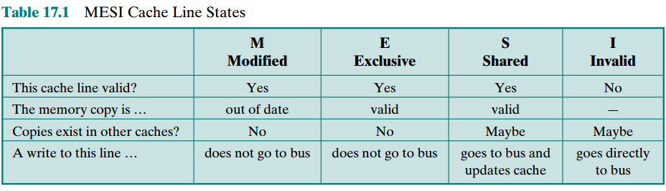
Table 17.1
MESI Cache Line States
Table 17.1 summarizes the meaning of the four states.
Notes:
Table 17.1 summarizes the meaning of the four states.

Slide 24
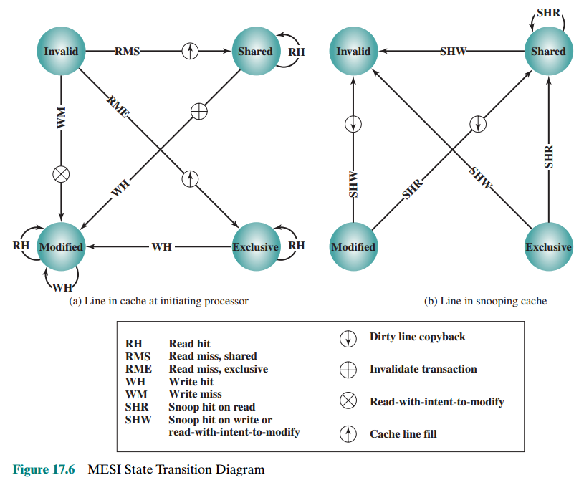
MESI State Transition Diagram
Notes:
Giải thich theo từng trường hợp theo hình a và b
RH đọc đúng
RMS đọc sai
WH ghi đúng
WM ghi sai
Figure 17.6 displays a state diagram for the MESI protocol. Keep in mind that each line of the cache has its own state bits and therefore its own realization of the state diagram. Figure 17.6a shows the transitions that occur due to actions initiated by the processor attached to this cache. Figure 17.6b shows the transitions that occur due to events that are snooped on the common bus. This presentation of separate state diagrams for processor-initiated and bus-initiated actions helps to clarify the logic of the MESI protocol.
At any time a cache line is in a single state. If the next event is from the attached processor, then the transition is dictated by Figure 17.6a and if the next event is from the bus, the transition is dictated by Figure 17.6b.

Slide 25
17.4- Multithreading and Chip Multiprocessors
Processor performance can be measured by the rate at which it executes instructions
MIPS rate = f * IPC // Million Instructions Per second
  f = processor clock frequency, in MHz
  IPC=average Instructions Per Cycle
Increase performance by increasing clock frequency and increasing instructions that complete during cycle
Multithreading
  Allows for a high degree of instruction-level parallelism without increasing circuit complexity or power consumption → Increase IPC
  Instruction stream is divided into several smaller streams, known as threads, that can be executed in parallel
Notes:
The most important measure of performance for a processor is the rate at which it executes instructions. This can be expressed as
MIPS rate = f * IPC
where f is the processor clock frequency, in MHz, and IPC (instructions per cycle) is the average number of instructions executed per cycle. Accordingly, designers have pursued the goal of increased performance on two fronts: increasing clock frequency and increasing the number of instructions executed or, more properly, the number of instructions that complete during a processor cycle. As we have seen in earlier chapters, designers have increased IPC by using an instruction pipeline and then by using multiple parallel instruction pipelines in a superscalar architecture. With pipelined and multiple-pipeline designs, the principal problem is to maximize the utilization of each pipeline stage. To improve throughput, designers have created ever more complex mechanisms, such as executing some instructions in a different order from the way they occur in the instruction stream and beginning execution of instructions that may never be needed. But as was discussed in Section 2.2, this approach may be reaching a limit due to complexity and power consumption concerns.
An alternative approach, which allows for a high degree of instruction-level parallelism without increasing circuit complexity or power consumption, is called multithreading. In essence, the instruction stream is divided into several smaller streams, known as threads, such that the threads can be executed in parallel.
The variety of specific multithreading designs, realized in both commercial systems and experimental systems, is vast. In this section, we give a brief survey of the major concepts.

Slide 26
Definitions of Threads and Processes
Thread in multithreaded processors may or may not be the same as the concept of software threads in a multiprogrammed operating system
Thread is concerned with scheduling and execution, whereas a process is concerned with both scheduling/execution and resource and resource ownership
Process:
An instance of program running on computer
Two key characteristics:
Resource ownership
Scheduling/execution
Process switch
Operation that switches the processor from one process to another by saving all the process control data, registers, and other information for the first and replacing them with the process information for the second
Thread:
Dispatchable unit of work within a process
Includes processor context (which includes the program counter and stack pointer) and data area for stack
Executes sequentially and is interruptible so that the processor can turn to another thread
Thread switch
The act of switching processor control between threads within the same process
Typically less costly than process switch
Notes:
The concept of thread used in discussing multithreaded processors may or may not be the same as the concept of software threads in a multiprogrammed operating system. It will be useful to define terms briefly:
• Process: An instance of a program running on a computer. A process embodies two key characteristics:
—Resource ownership: A process includes a virtual address space to hold the process image; the process image is the collection of program, data, stack, and attributes that define the process. From time to time, a process may be allocated control or ownership of resources, such as main memory, I/O channels, I/O devices, and files.
—Scheduling/execution: The execution of a process follows an execution path (trace) through one or more programs. This execution may be inter- leaved with that of other processes. Thus, a process has an execution state (Running, Ready, etc.) and a dispatching priority and is the entity that is scheduled and dispatched by the operating system.
Process switch: An operation that switches the processor from one process to another, by saving all the process control data, registers, and other information for the first and replacing them with the process information for the second.2
Thread: A dispatchable unit of work within a process. It includes a processor context (which includes the program counter and stack pointer) and its own data area for a stack (to enable subroutine branching). A thread executes sequentially and is interruptible so that the processor can turn to another thread.
Thread switch: The act of switching processor control from one thread to an- other within the same process. Typically, this type of switch is much less costly than a process switch.
Thus, a thread is concerned with scheduling and execution, whereas a process is concerned with both scheduling/execution and resource ownership. The multiple threads within a process share the same resources. This is why a thread switch is much less time consuming than a process switch. Traditional operating systems, such as earlier versions of UNIX, did not support threads. Most modern operating systems, such as Linux, other versions of UNIX, and Windows, do support thread. A distinction is made between user-level threads, which are visible to the application program, and kernel-level threads, which are visible only to the operating sys- tem. Both of these may be referred to as explicit threads, defined in software.

Slide 27
Implicit and Explicit Multithreading
All commercial processors and most experimental ones use explicit multithreading
  Concurrently execute instructions from different explicit threads
  Interleave instructions from different threads on shared pipelines or parallel execution on parallel pipelines
Implicit multithreading is concurrent execution of multiple threads extracted from single sequential program
  Implicit threads defined statically by compiler or dynamically by hardware
Notes:
All of the commercial processors and most of the experimental processors so far have used explicit multithreading. These systems concurrently execute instructions from different explicit threads, either by interleaving instructions from different threads on shared pipelines or by parallel execution on parallel pipelines. Implicit multithreading refers to the concurrent execution of multiple threads extracted from a single sequential program. These implicit threads may be defined either statically by the compiler or dynamically by the hardware. In the remainder of this section we consider explicit multithreading.

Slide 28
Approaches to Explicit Multithreading
Interleaved
  Fine-grained (divided)
  Processor deals with two or more thread contexts at a time
  Switching thread at each clock cycle
  If thread is blocked it is skipped
Simultaneous (SMT)
  Instructions are simultaneously issued from multiple threads to execution units of superscalar processor
Blocked
  Coarse-grained (no fine)
  Thread executed until event causes delay (IO)
  Effective on in-order processor
  Avoids pipeline stall (failure)
Chip multiprocessing
  Processor is replicated on a single chip
  Each processor handles separate threads
  Advantage is that the available logic area on a chip is used effectively
SMT: Simultaneous Multithreading
Notes:
Broadly speaking, there are four principal approaches to multithreading:
• Interleaved multithreading: This is also known as fine-grained multithreading. The processor deals with two or more thread contexts at a time, switching from one thread to another at each clock cycle. If a thread is blocked because of data dependencies or memory latencies, that thread is skipped and a ready
thread is executed.
Blocked multithreading: This is also known as coarse-grained multithreading. The instructions of a thread are executed successively until an event occurs that may cause delay, such as a cache miss. This event induces a switch to another thread. This approach is effective on an in-order processor that would stall the pipeline for a delay event such as a cache miss.
Simultaneous multithreading (SMT): Instructions are simultaneously issued from multiple threads to the execution units of a superscalar processor. This combines the wide superscalar instruction issue capability with the use of multiple thread contexts.
Chip multiprocessing: In this case, the entire processor is replicated on a single chip and each processor handles separate threads. The advantage of this approach is that the available logic area on a chip is used effectively without depending on ever-increasing complexity in pipeline design.

Slide 29
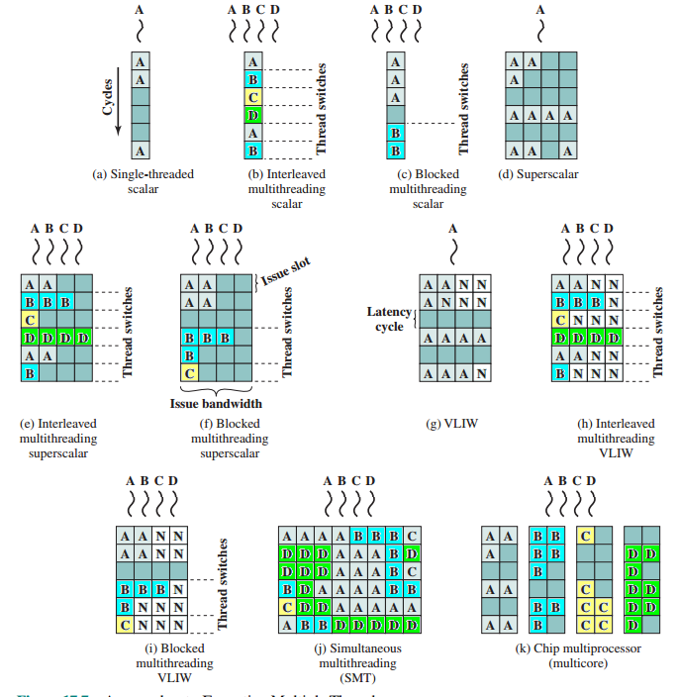
Approaches to Executing Multiple Threads
Notes:
For the first two approaches, instructions from different threads are not executed simultaneously. Instead, the processor is able to rapidly switch from one thread to another, using a different set of registers and other context information. This results in a better utilization of the processor’s execution resources and avoids a large penalty due to cache misses and other latency events. The SMT approach involves true simultaneous execution of instructions from different threads, using replicated execution resources. Chip multiprocessing also enables simultaneous execution of instructions from different threads.
Figure 17.7, based on one in [UNGE02], illustrates some of the possible pipe- line architectures that involve multithreading and contrasts these with approaches that do not use multithreading. Each horizontal row represents the potential issue slot or slots for a single execution cycle; that is, the width of each row corresponds to the maximum number of instructions that can be issued in a single clock cycle.3 The vertical dimension represents the time sequence of clock cycles. An empty (shaded) slot represents an unused execution slot in one pipeline. A no-op is indicated by N.
The first three illustrations in Figure 17.7 show different approaches with a scalar (i.e., single-issue) processor:
Single-threaded scalar: This is the simple pipeline found in traditional RISC and CISC machines, with no multithreading.
Interleaved multithreaded scalar: This is the easiest multithreading approach to implement. By switching from one thread to another at each clock cycle, the pipeline stages can be kept fully occupied, or close to fully occupied. The hardware must be capable of switching from one thread context to another between cycles.
• Blocked multithreaded scalar: In this case, a single thread is executed until a latency event occurs that would stop the pipeline, at which time the processor
switches to another thread.
In the case of interleaved multithreading, it is assumed that there are no control or data dependencies between threads, which simplifies the pipeline design and there- fore should allow a thread switch with no delay. However, depending on the specific design and implementation, block multithreading may require a clock cycle to per- form a thread switch, as illustrated in Figure 17.7. This is true if a fetched instruction triggers the thread switch and must be discarded from the pipeline [UNGE03].
Although interleaved multithreading appears to offer better processor utilization than blocked multithreading, it does so at the sacrifice of single-thread performance. The multiple threads compete for cache resources, which raises the probability of a cache miss for a given thread.
More opportunities for parallel execution are available if the processor can issue multiple instructions per cycle. Figures 17.7d through 17.7i illustrate a number of variations among processors that have hardware for issuing four instructions per cycle.
Figure 17.7c shows a situation in which the time to perform a thread switch is one cycle, whereas Figure 17.7b shows that thread switching occurs in zero cycles.

Slide 30
Example Systems
Pentium 4
IBM Power5
More recent models of the Pentium 4 use a multithreading technique that Intel refers to as hyperthreading
Approach is to use SMT with support for two threads
Thus the single multithreaded processor is logically two processors
Chip used in high-end PowerPC products
Combines chip multiprocessing with SMT
  Has two separate processors, each of which is a multithreaded processor capable of supporting two threads concurrently using SMT
  Designers found that having two two-way SMT processors on a single chip provided superior performance to a single four-way SMT processor
Notes:
More recent models of the Pentium 4 use a multithreading technique that the Intel literature refers to as hyperthreading [MARR02]. In essence, the Pentium 4 approach is to use SMT with support for two threads. Thus, the single multithreaded processor is logically two processors.
The IBM Power5 chip, which is used in high-end PowerPC products, combines chip multiprocessing with SMT [KALL04]. The chip has two separate processors, each of which is a multithreaded processor capable of supporting two threads concurrently using SMT. Interestingly, the designers simulated various alternatives and found that having two two-way SMT processors on a single chip provided superior performance to a single four-way SMT processor. The simulations showed that additional multithreading beyond the support for two threads might decrease performance because of cache thrashing, as data from one thread displaces data needed by another thread.

Slide 31
Exercises
17.1 List and briefly define three types of computer system organization.
17.2 What are the chief characteristics of an SMP(symmetric multiprocessor)?
17.3 What are some of the potential advantages of an SMP compared with a uniprocessor?
17.4 What are some of the key OS design issues for an SMP?
17.5 What is the difference between software and hardware cache coherent schemes?
17.6 What is the meaning of each of the four states in the MESI protocol?

Slide 32
Summary
Parallel
Processing
Chapter 17
  Multiple processor organizations
  Types of parallel processor systems
  Parallel organizations
  Symmetric multiprocessors
  Organization
  Multiprocessor operating system design considerations
  Cache coherence and the MESI protocol
  Software solutions
  Hardware solutions
  The MESI protocol
  Multithreading and chip multiprocessors
  Implicit and explicit multithreading
  Approaches to explicit multithreading
  Example systems
Notes:
Chapter 17 summary.

